Slide 1
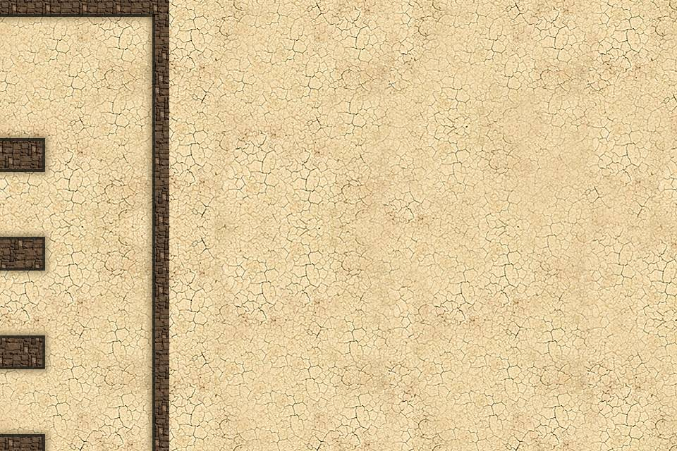
National MD
Team:NMD

Slide 2
Two part
LOGIN
To store the user'information
GAME PART
Include the game code

Slide 3
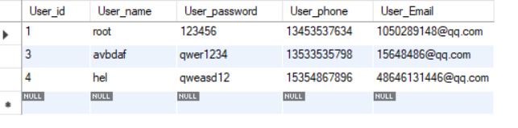
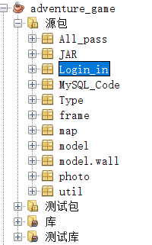
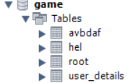

Slide 4
LOGIN PART
It include four small part:Login part,Regisiter part, Fogrgetusername part,ForgetPassword part.
Regisiter part: It create a new user table using JDBC in Database ,which contains the User name,Password,Email and Phone Number ;
Login part :It wil seek your information of your User name and password both are
right.And display it in the screen;
Forgetusername part:It use your phone number and email to match with the data in database.And if it succeed ,you will find your Username;
ForgetPassword:It use your phone number and username to match with the data in database.And if it succeed ,you will find your Password;

Slide 5
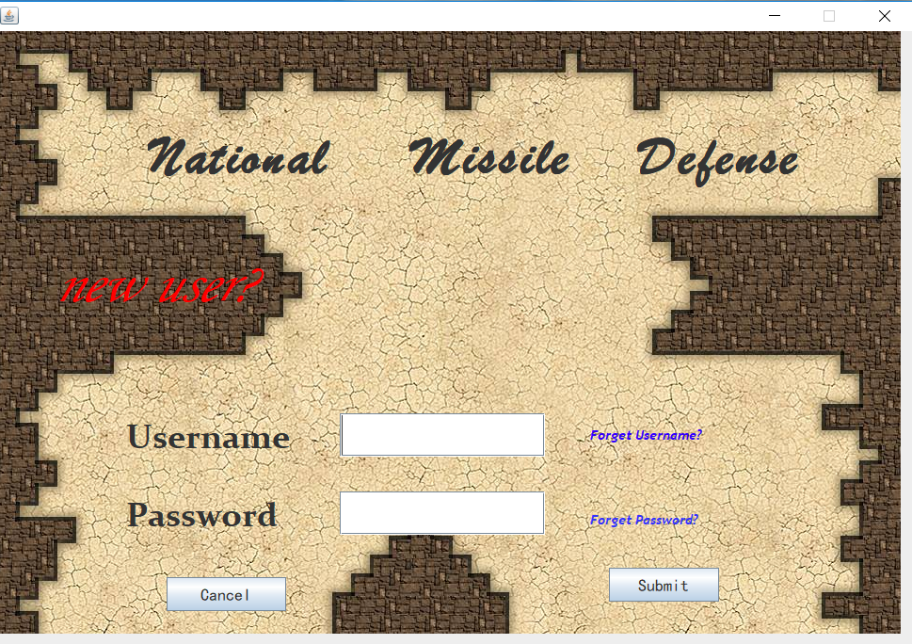
This is login interface

Slide 6
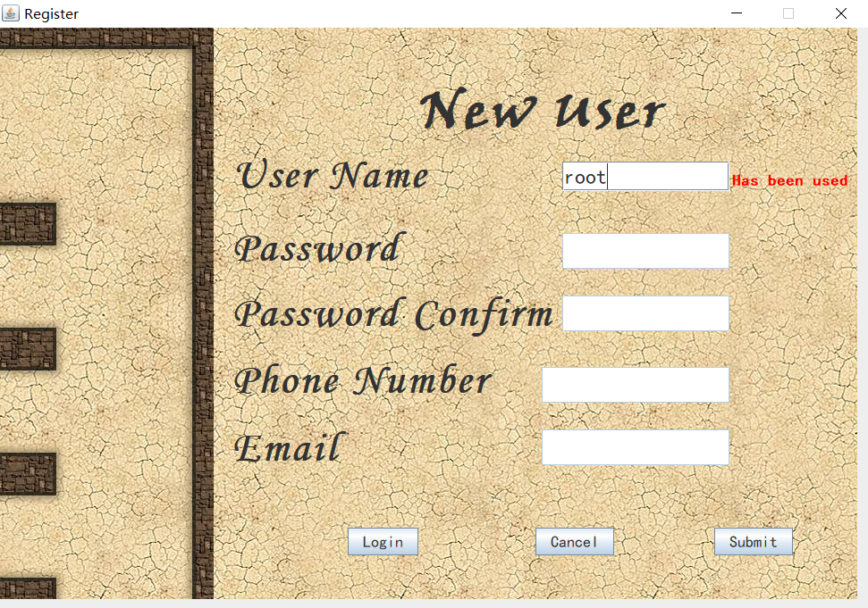
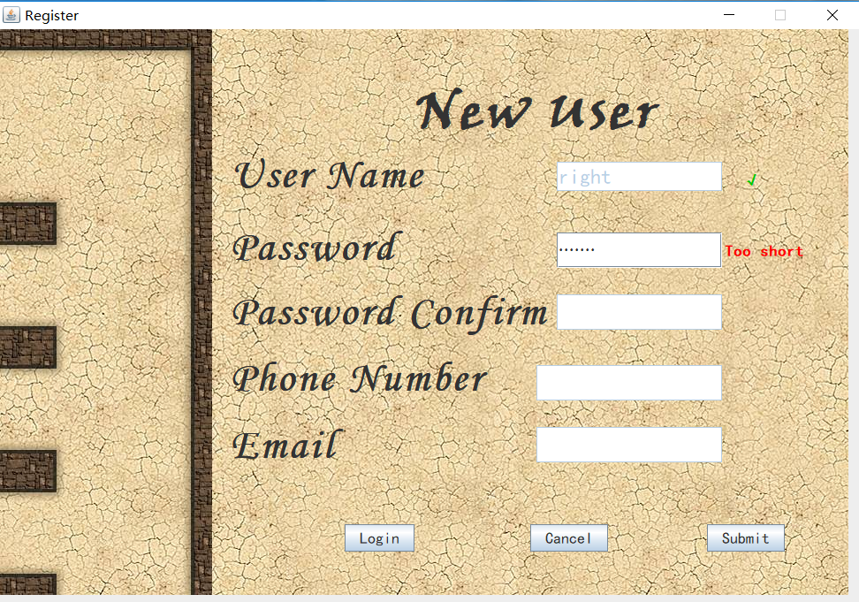
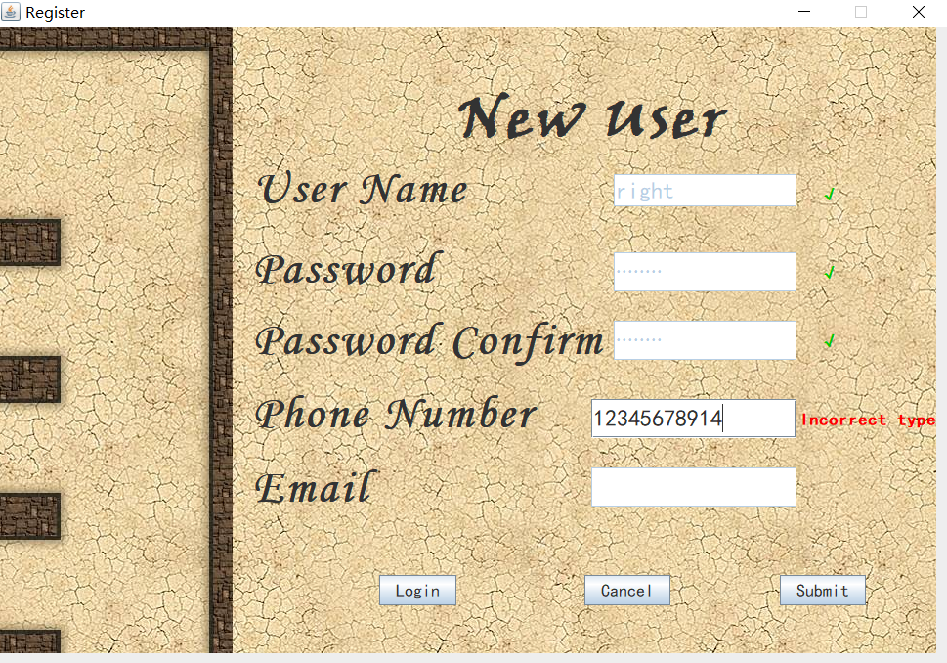
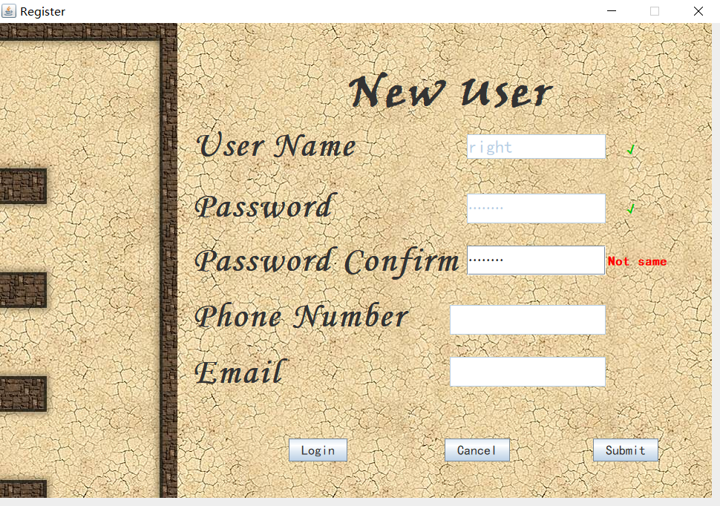
The registered test

Slide 7
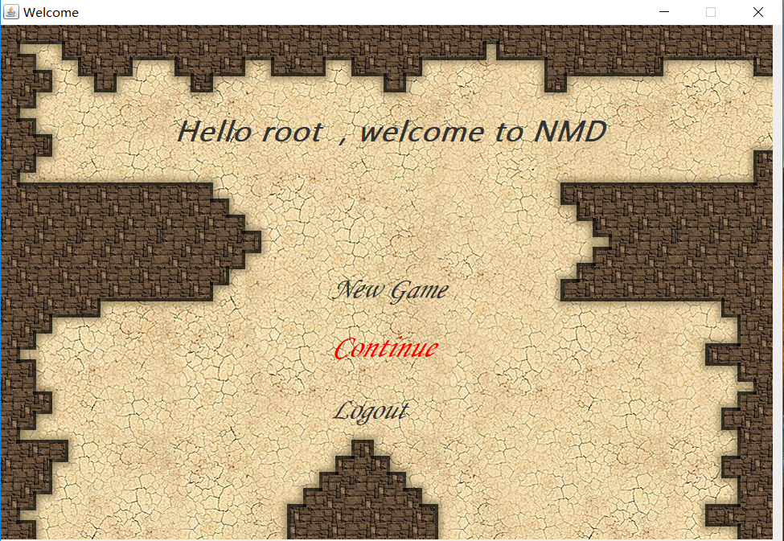

Slide 8
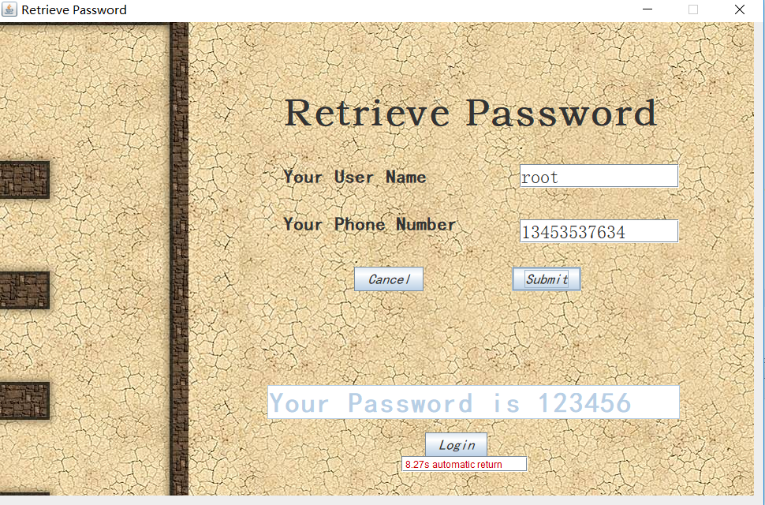
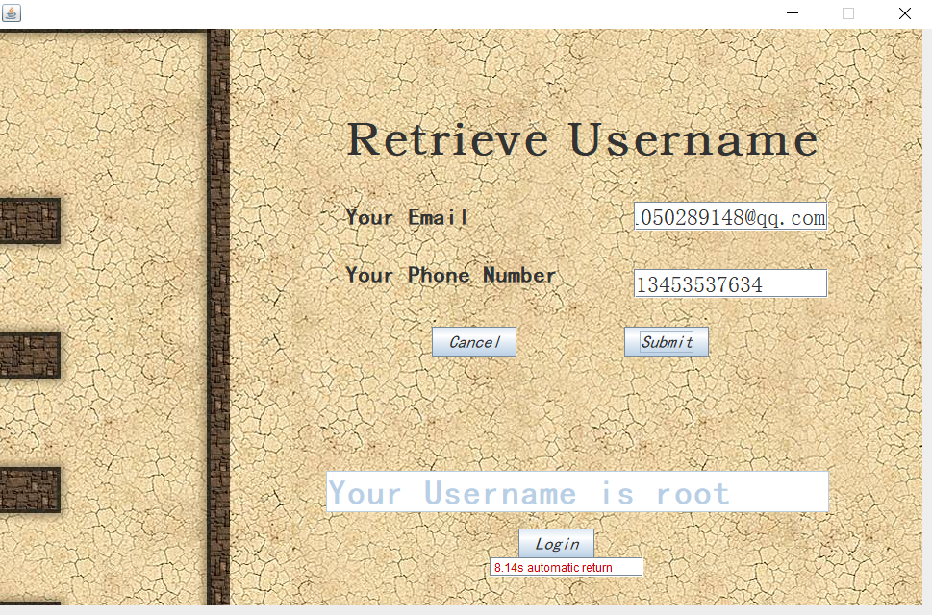

Slide 9
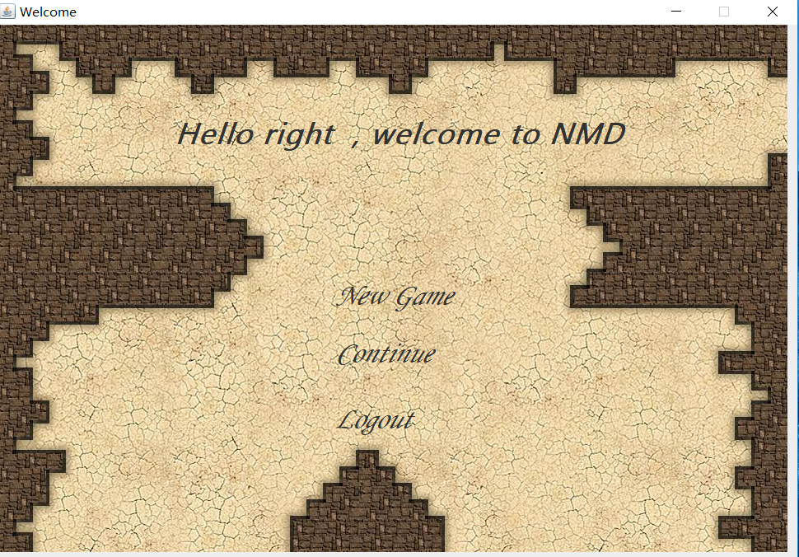
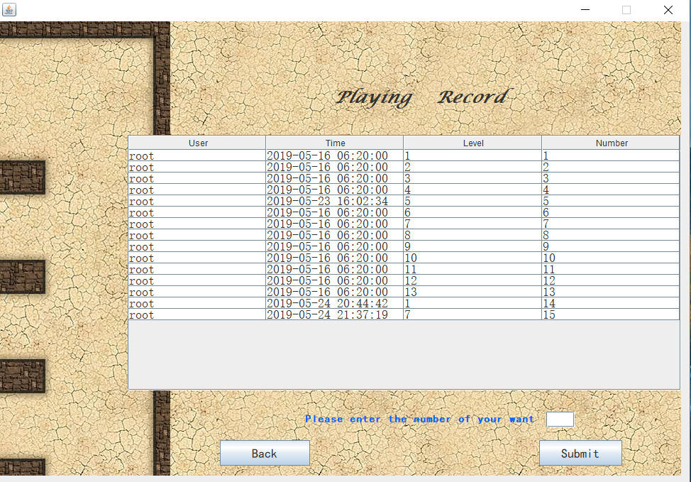

Slide 10
GAME PART
It include two part:
The Model part
The Frame part

Slide 11
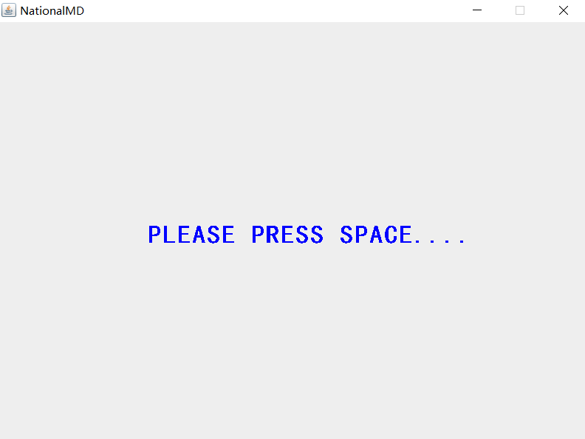
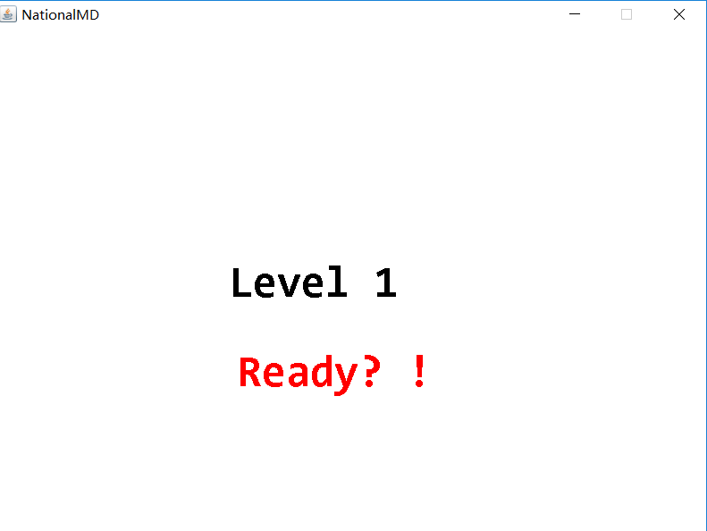

Slide 12
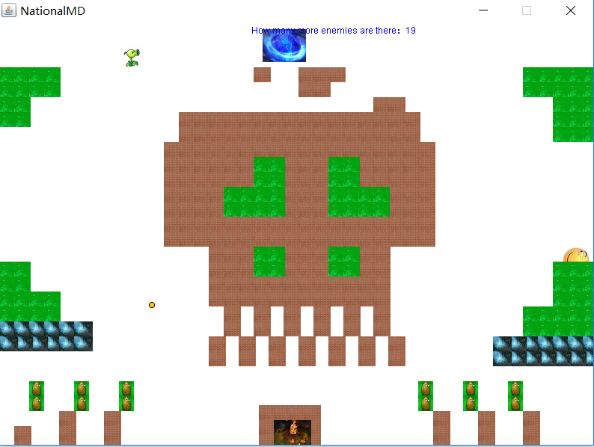
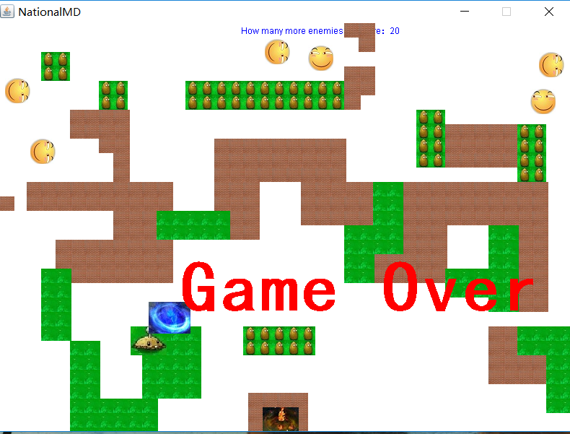

Slide 13
Model Part
Wall Part:List<wall>,Grass wall,Sea wall,Iron wall,brick wall,river wall and base;
Bullet Part:It has collison detecion which will test whether bullet hit the others.It also has some properties and methods;
Tank Part:It has some common ground point with the Bullet.For example,the collision detection

Slide 14
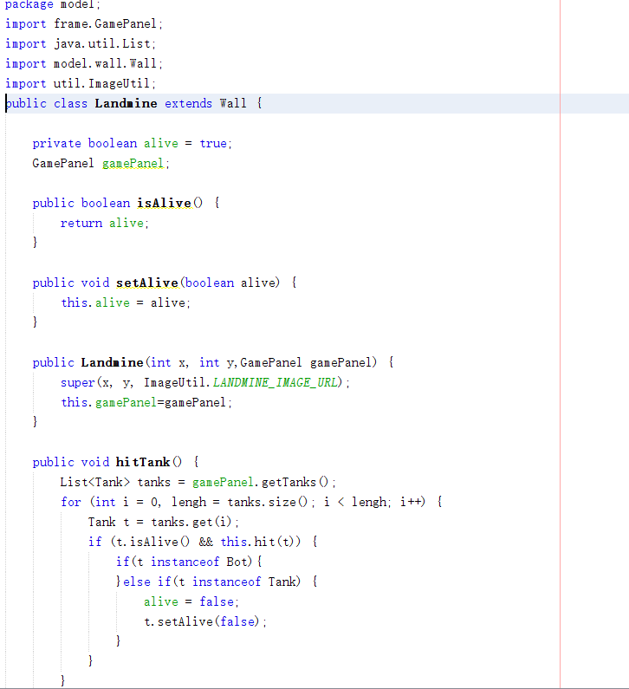
The class of landmine

Slide 15
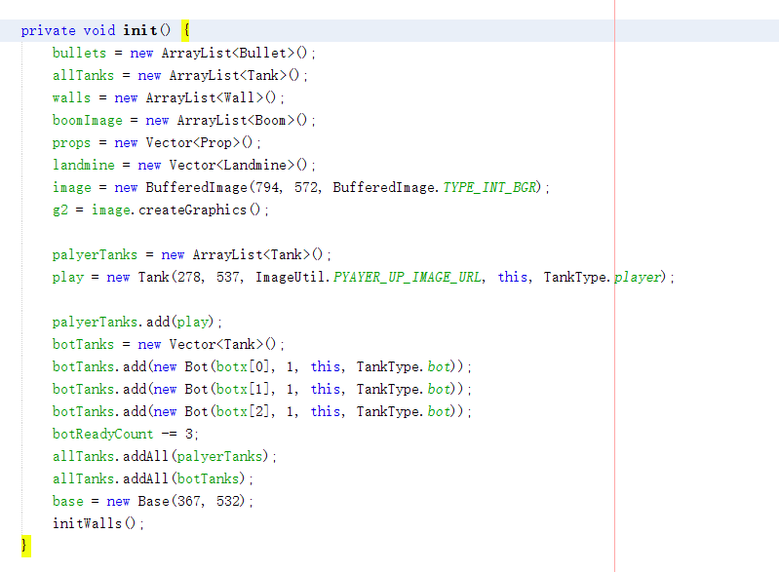
Initial interface

Slide 16
Frame Part
Level part:It include recording the gate number,flash amination,and come into the GamePanel.
GamePanel:It includes refreshing the frame,painting the element in the game ,adding keylistenner and judge if you are win;

Slide 17
The process
s
Y
N Y
N
Y
Start
Login
Enter into records
Restart
Enter into gamepanel
Die？
Des?
Win？
The next

